Slide 1
THE NEED FOR QUANTUM MECHANICS
Part I Wave-particle duality and why it makes such a disturbing theory necessary,
Part II What quantum mechanics says about the material world and about measurement
Part III What of its properties make quantum theory of so much interest to cryptographers on whose work all secure data exchange and storage fundamental to individual privacy and national security now rely.
Notes:
Talks to provide background of ideas and vocabulary necessary to understand interest in and difficulties of quantum computing and quantum cryptography

Slide 2
PARTICLES
    localized in space
    inertial mass m, momentum p
WAVES
waves are continuously distributed in space
examples of waves
  water
  sound
  light (electromagnetic)
periodic waves
  wavelength
  frequency
  velocity
addition of waves = superposition
  a traveling pulse

Slide 3
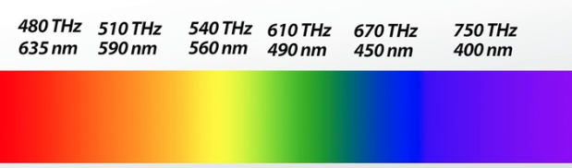

AN INTERLUDE WITH GRAPHER
wavelength
period
frequency
phase
amplitude
superposition
frequency
wavelength
Interference is another name for superposition
  constructive interference
  destructive interference
Notes:
red diode laser wavelength is around 650 nm

Slide 4
How do you know if something is a wave?
Interference
two-slit ripple tank
https://www.youtube.com/watch?v=UMkAXvWIRY4
If it exhibits interference, it is a wave.

Slide 5
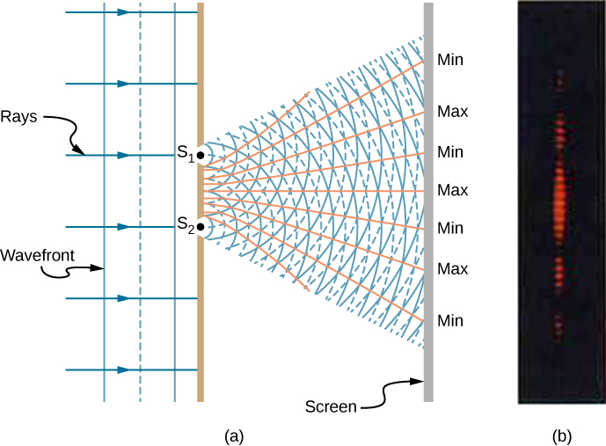
INTERFERENCE MEANS LIGHT IS A WAVE
Notes:
Light has two paths to the detector
https://phys.libretexts.org/Bookshelves/University_Physics/Book%3A_University_Physics_(OpenStax)/Map%3A_University_Physics_III_-_Optics_and_Modern_Physics_(OpenStax)/3%3A_Interference/3.1%3A_Young%27s_Double-Slit_Interference

Slide 6
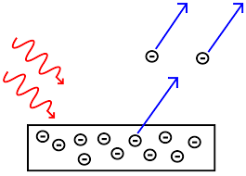
PHOTOELECTRIC EFFECT
Known since 1880s
UV light (short wavelength) causes emission of electrons from metal surfaces
electrons come off with various energies but with a well defined maximum E_{max}
cutoff wavelength (value depends on the kind of metal)
below cutoff increased intensity has no effect
above cutoff weakened intensity lowers yield of e’s
but for very weak beam there is no delay in emission i.e. there is no gradual buildup of energy from light – all at once or nothing

Slide 7
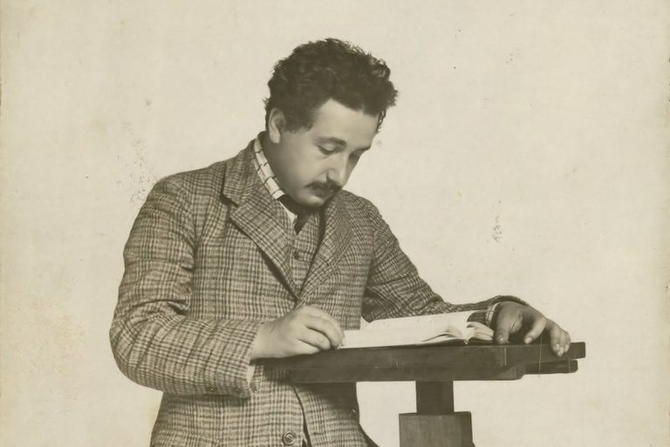
Patent Examiner 1902-09
In 1905 Albert Einstein was a Technical Expert 3rd Class in the Swiss patent office in Berne.
E = hf
“According to the assumption considered here, in the propagation of a light ray emitted from a point source, the energy is not distributed continuously over ever-increasing volumes of space, but consists of a finite number of energy quanta localized at points of space that move without dividing, and can be absorbed or generated only as complete units.” [from his article in Annalen der Physik 1905]
Notes:
Albert Einstein, ``On a heuristic point of view concerning the production and transformation of light," p.~177-198 of {\em Einstein's Miraculous Year}, ed. John Stachel, Princeton University Press (1998). This is an English translation of Einstein's 1905 paper ``\"{U}ber einen die Erzeugung und Verwandlung des Lichtes betreffenden heuristischen Gesichtspunkt," in {\em Annalen der Physik} {\bf 17}, 132-148 (1905).

Slide 8
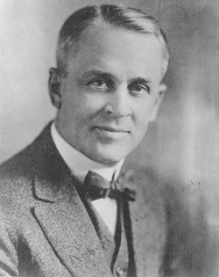
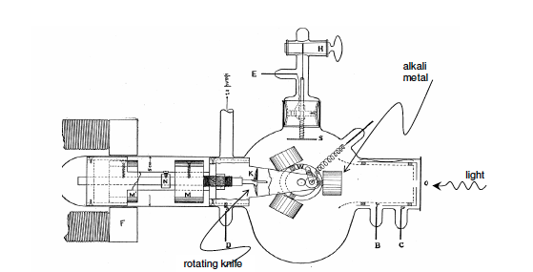
ROBERT A. MILLIKAN
[Einstein’s] hypothesis may well be called reckless first because an electromagnetic disturbance which remains localized in space seems a violation of the very conception of an electromagnetic disturbance, and second because it flies in the face of the thoroughly established facts of interference. [Phys. Rev. 7, 355-388 (1916)
Notes:
Unit of self-conceit is the kan. That is too large a unit, so we use the millikan

Slide 9
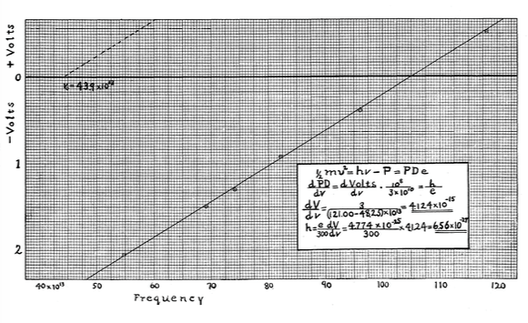
electrons come off with

Slide 10
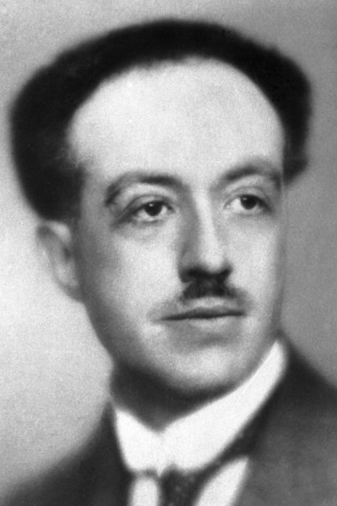
CLOSING PARAGRAPH OF LOUIS DE BROGLIE’S 1929 NOBEL LECTURE
Thus to describe the properties of matter as well as those of light, waves and corpuscles have to be referred to at one and the same time. The electron can no longer be conceived as a single, small granule of electricity; it must be associated with a wave and this wave is no myth; its wavelength can be measured and its interferences predicted. . . . And it is on this concept of the duality of waves and corpuscles in Nature, expressed in a more or less abstract form, that the whole recent development of theoretical physics has been founded and that all future development of this science will apparently have to be founded.
Prince Louis-Victor Pierre Raymond de Broglie 1892-1987
p is momentum
Notes:
de Broglie’s work was done in 1924 and motivated Schroedinger to develop quantum wave mechanics in the next two years.

Slide 11

This shows the electron buildup pattern one electron at a time. The electron detection rate was about 1 Hz. The first 22 seconds are displayed at the detection rate, the next 30 sec are sped up to 72x, then 20 sec at 210x. The last 20 seconds are slowed back down to the detection rate. The intensity is controlled by a time dependent function to increase visibility of the individual 'blobs' at the beginning

Slide 12
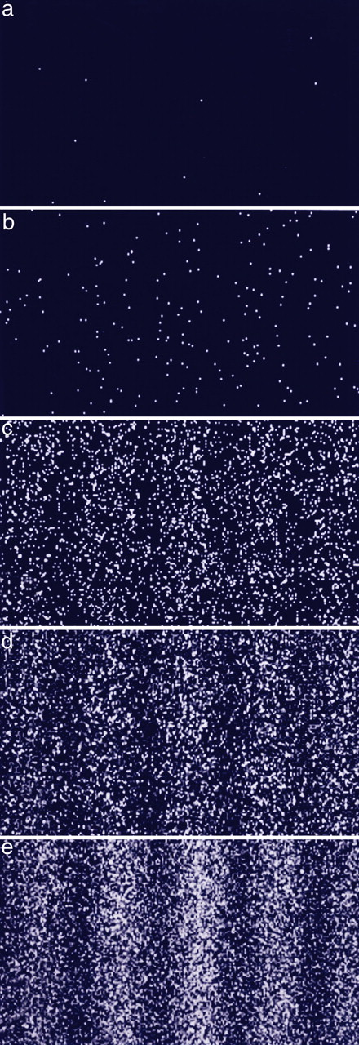

Build-up of an electron interference pattern.
Akira Tonomura PNAS 2005;102:42:14952-14959
©2005 by National Academy of Sciences
Notes:
Build-up of an electron interference pattern. Numbers of electrons are 10 (a), 200 (b), 6,000 (c), 40,000 (d), and 140,000 (e).

Slide 13
IMPLICATIONS OF
It takes a lot of energy to have wavelengths short enough to see small things
optical grating spacing ~10⁻⁶ m 1.24 eV
size of an atom ~10⁻¹⁰ m 12.4 keV
size of an atom’s nucleus ~10⁻¹⁴ m 124 MeV
size of a proton ~10⁻¹⁵ m 1.24 GeV
insides of a proton ~10⁻¹⁸ m 1.24 TeV
Planck length ~10⁻³⁵ m ~10¹⁷ TeV
Notes:
A digression, but I think it is interesting.

Slide 14
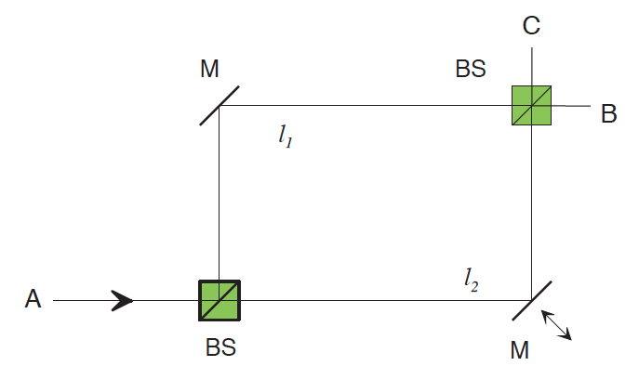
MACH-ZEHNDER INTERFEROMETER

Slide 15
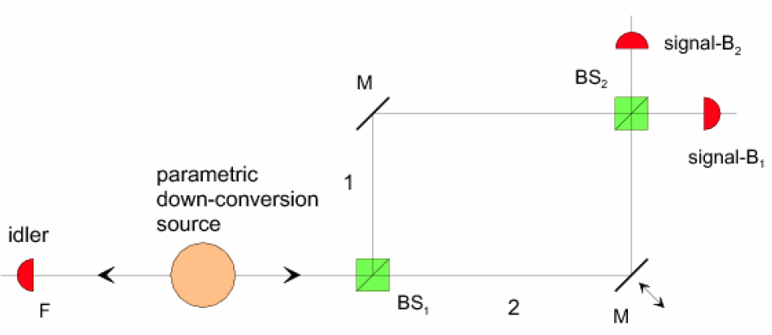
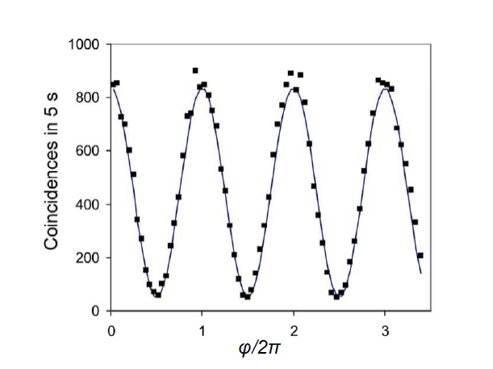
A PHOTON INTERFERES WITH ITSELF
Notes:
Device assures that only one photon is passing through at a time. Path length is varied by moving mirror M. Interference pattern is seen in variations of counts at B₁ (complementary curve occurs at B_{2.}

Slide 16
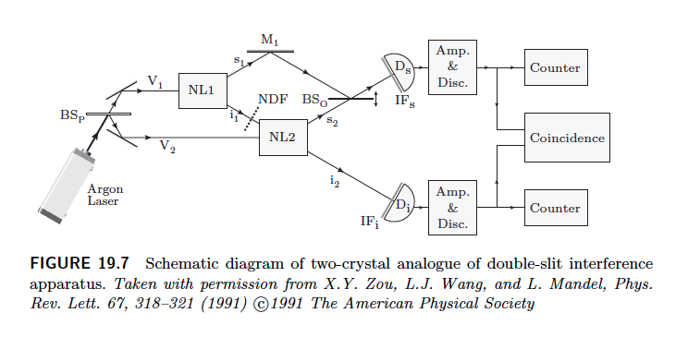
Interference can only occur between indistinguishable processes

Slide 17
Notes:
red diode laser is around 650 nm wavelength

